Slide 1
Assignment 3
DYOR!
Bitcoin use cases: For each use case, explain the added value of Bitcoin technology compared to existing solutions.
Payments, e.g.,
Cross-border transactions
Streaming payments
Privacy-focused transactions
etc.
Store of value
Financial inclusion (“banking the unbanked”)
Digital bearer instrument
Ordinals NFTs
What’s the future of Bitcoin?
Try to briefly sketch the future of Bitcoin and its use cases.
Identify at least 3 challenges that still need to be addressed for Bitcoin to reach its full potential.
Reminder: Create a Profile Slide for yourself in order to be listed as a Talent on our Bitcoin Talents website (see https://web3-talents.io/dlt-talents/dlt-talents-profiles/) - Deadline: Friday, February 23, 2024 (12:00 PM [CET/CEST])

Slide 2
Assignment:1.Bitcoin use cases: For each use case, explain the added value of Bitcoin technology compared to existing solutions.
1.a.i.Pyament:Cross-border transactions
Traditional System: International money transfers are usually handled by banks or specialized services like Western Union. These transactions can take several days to clear and often involve high fees, especially for smaller amounts. They also require the sender and receiver to have bank accounts, which might not be accessible to everyone.
Bitcoin's Added Value:
Lower Fees: Bitcoin can significantly reduce the transaction fees, especially for small and medium-sized transactions, as it eliminates the need for intermediaries.
Speed: Bitcoin transactions can be confirmed within minutes or hours, regardless of the countries involved.
Accessibility: With Bitcoin, all one needs is an internet connection and a digital wallet, making it possible for the unbanked or underbanked populations to send and receive money across borders.

Slide 3
Assignment:1.Bitcoin use cases: For each use case, explain the added value of Bitcoin technology compared to existing solutions.
1.a.ii.Pyament:Streaming payments
Traditional System: Recurring payments or subscriptions are typically processed through banks or credit card companies, which can impose fees and require a complex setup for both parties.
Bitcoin's Added Value:
Micropayments: Bitcoin, especially when used with second-layer solutions like the Lightning Network, makes it economically feasible to do streaming payments or micropayments, which are continuous small payments for services, such as streaming content by the minute.
Instant Settlements: Payments are settled as soon as they are made, without waiting for bank processing times.
Programmability: Bitcoin allows for programmable money through scripts, enabling automated and conditional streaming payments without needing a third-party service.

Slide 4
Assignment:1.Bitcoin use cases: For each use case, explain the added value of Bitcoin technology compared to existing solutions.
1.a.iii.Pyament:Privacy-focused transactions
Traditional System: Banks and financial institutions must comply with KYC (Know Your Customer) and AML (Anti-Money Laundering) regulations, which means that users' financial transactions are not private.
Bitcoin's Added Value:
Pseudonymity: Bitcoin transactions are pseudonymous; they do not directly reveal the identity of the transacting parties, although transactions are public on the blockchain.
Control over Personal Data: Users have more control over their personal data as they do not need to share it with banks or other institutions when transacting.
Enhanced Privacy Options: There are additional privacy-focused tools and methods available in the Bitcoin ecosystem, like mixing services and privacy-focused wallets that can increase transaction privacy.

Slide 5
Assignment:1.Bitcoin use cases: For each use case, explain the added value of Bitcoin technology compared to existing solutions.
1.b.Store of value
Traditional System: Gold and other precious metals have historically been the store of value, but they are not easily divisible or transferable, and physical storage can be challenging and expensive.
Bitcoin's Added Value: Often referred to as "digital gold," Bitcoin provides a modern alternative that is easily transferable, divisible, and can be stored securely and privately, making it accessible for store of value purposes globally.

Slide 6
Assignment:1.Bitcoin use cases: For each use case, explain the added value of Bitcoin technology compared to existing solutions.
1.c.Financial inclusion (“banking the unbanked”)
Traditional System: Traditional banking requires physical infrastructure and documentation that may not be accessible to everyone, leaving a significant portion of the global population unbanked.
Bitcoin's Added Value: Bitcoin requires only an internet connection and a digital wallet, offering financial services to those without access to traditional banking. This includes the ability to save, send, and receive funds.

Slide 7
Assignment:1.Bitcoin use cases: For each use case, explain the added value of Bitcoin technology compared to existing solutions.
1.d.Digital bearer instrument
Traditional System: Bearer instruments in the traditional sense (like bearer bonds) are not common due to security and regulatory issues.
Bitcoin's Added Value: Bitcoin acts as a digital bearer instrument where the holder of the private keys controls the associated bitcoins. It is secure, transferable, and resistant to censorship.

Slide 8
Assignment:1.Bitcoin use cases: For each use case, explain the added value of Bitcoin technology compared to existing solutions.
1.e.Ordinals NFTs
Traditional System: NFTs are typically associated with blockchains like Ethereum, and their creation and transfer involve complex smart contract interactions.
Bitcoin's Added Value: Bitcoin Ordinals inscribe satoshis (the smallest unit of bitcoin) with unique data, turning them into non-fungible tokens. This leverages Bitcoin's security and robustness for NFTs without the need for smart contracts, albeit in a more primitive form compared to other blockchains designed for complex NFT interactions.

Slide 9
Assignment:2.What’s the future of Bitcoin?
1.a.Try to briefly sketch the future of Bitcoin and its use cases.
Potential Future and Use Cases:
1.Mainstream Adoption: Bitcoin could become more widely accepted as a form of payment, not just for online transactions but also in brick-and-mortar stores, much like credit cards.
2.Store of Value: Bitcoin is often referred to as "digital gold" and may continue to be used as a hedge against inflation and currency devaluation, especially in countries with unstable economies.
3.Remittance and Cross-Border Transactions: Bitcoin could streamline remittances, allowing for instant and low-cost international transfers, beneficial for global workforces and expatriates.
4.Financial Inclusion: Bitcoin might play a crucial role in providing financial services to the unbanked population, thus democratizing access to the global economy.
5.Smart Property and Tokenization: The technology behind Bitcoin, the blockchain, could be used to create smart property and facilitate the tokenization of real-world assets, enabling easier and more secure transfer of ownership.

Slide 10
Assignment:2.What’s the future of Bitcoin?
1.b.Identify at least 3 challenges that still need to be addressed for Bitcoin to reach its full potential.
Scalability: One of the most significant challenges facing Bitcoin is its limited transaction throughput compared to traditional payment systems like Visa or PayPal. Solutions such as the Lightning Network are in development to address this, but widespread adoption and proof of long-term viability are still required.
Regulatory Environment: The legal landscape for Bitcoin is still uncertain in many parts of the world. Regulatory clarity and supportive legislation will be essential for Bitcoin to achieve its full potential, especially concerning tax laws, anti-money laundering (AML) standards, and know your customer (KYC) regulations.
Volatility: The price of Bitcoin is known for its volatility, which can be a hindrance to its use as a medium of exchange or unit of account. For businesses and consumers to adopt Bitcoin widely, they need some level of price stability or effective hedging mechanisms.

Slide 11
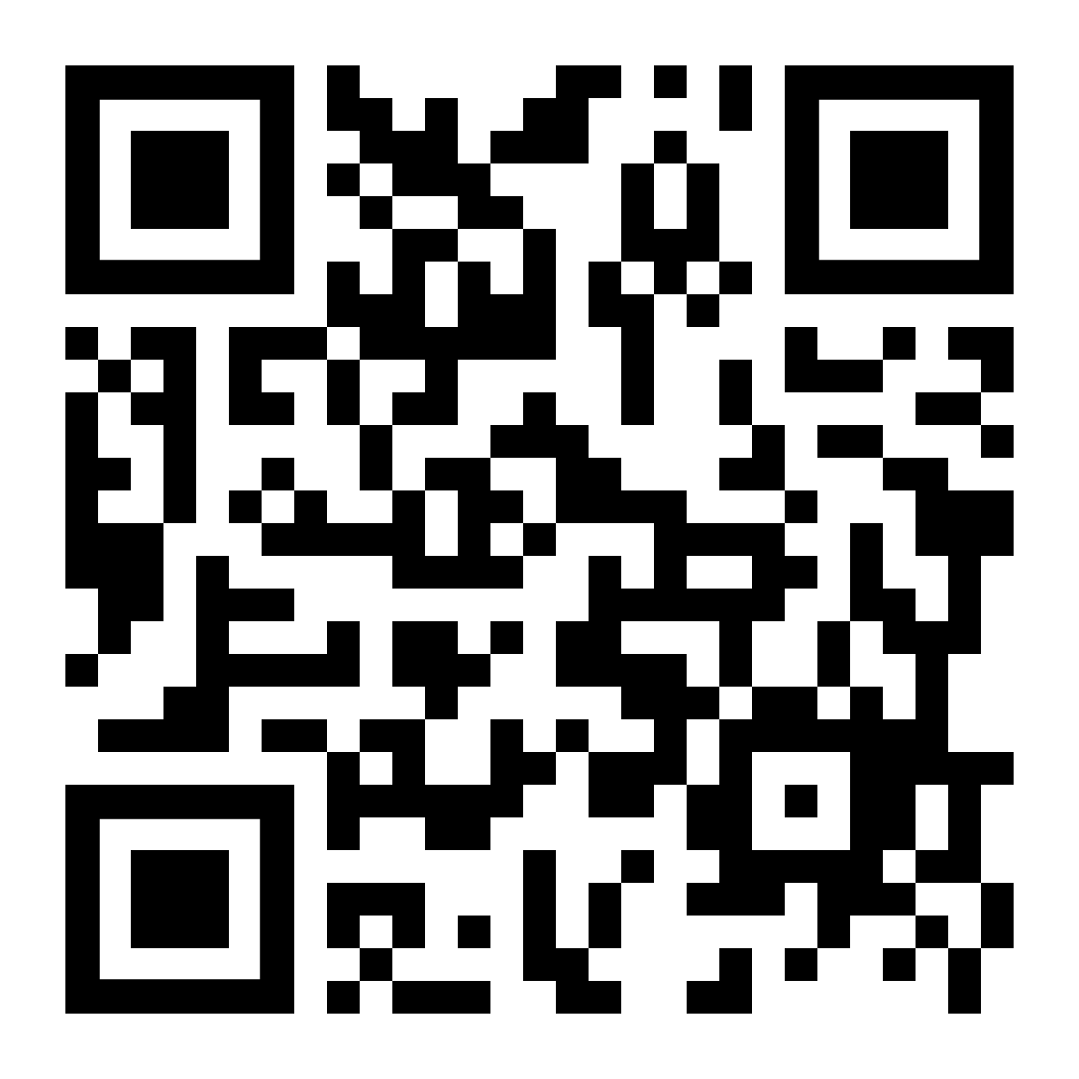
Submit Assignment
https://forms.gle/iRNjCf8TCHi8My7v5
You can use the Content Questionnaire to submit content, e.g., articles, studies, projects relevant to Bitcoin (needs to have relevant Bitcoin insights/content)

